Slide 1
Mobile App Quick Start Guide
(iPhone Version)

Slide 2
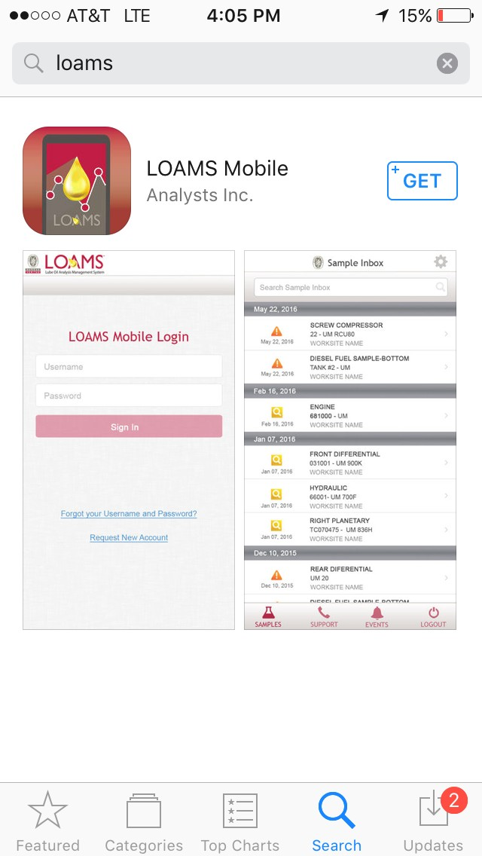
To find the app in the app store, search for “LOAMS”
Tap on the +GET button to install the app on your iPhone/iPad

Slide 3
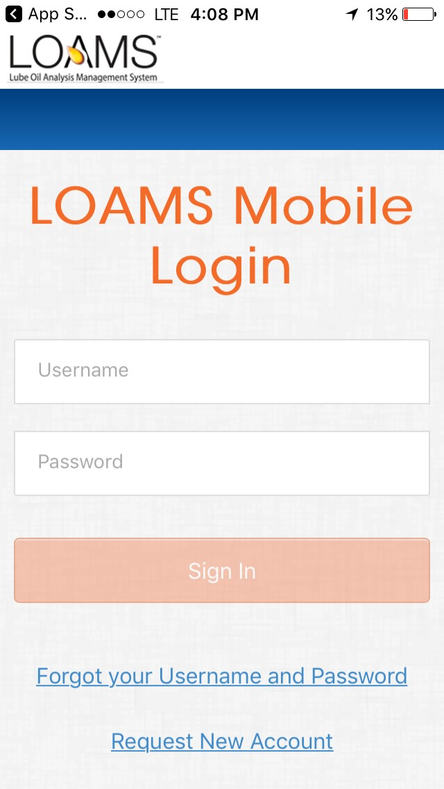
Enter in your username and password and tap on the Sign In button. Your log in credentials are the same as the desktop version.
If you’ve forgotten your username and/or password click on the Forgot your Username and Password link, then enter in your email address and a new password will be sent to your email shortly.
If you are new to LOAMS you can request a new account by clicking on the Request New Account link and setting up your username and password. Please note that it may take up to 48 hours for your new account to be activated.

Slide 4
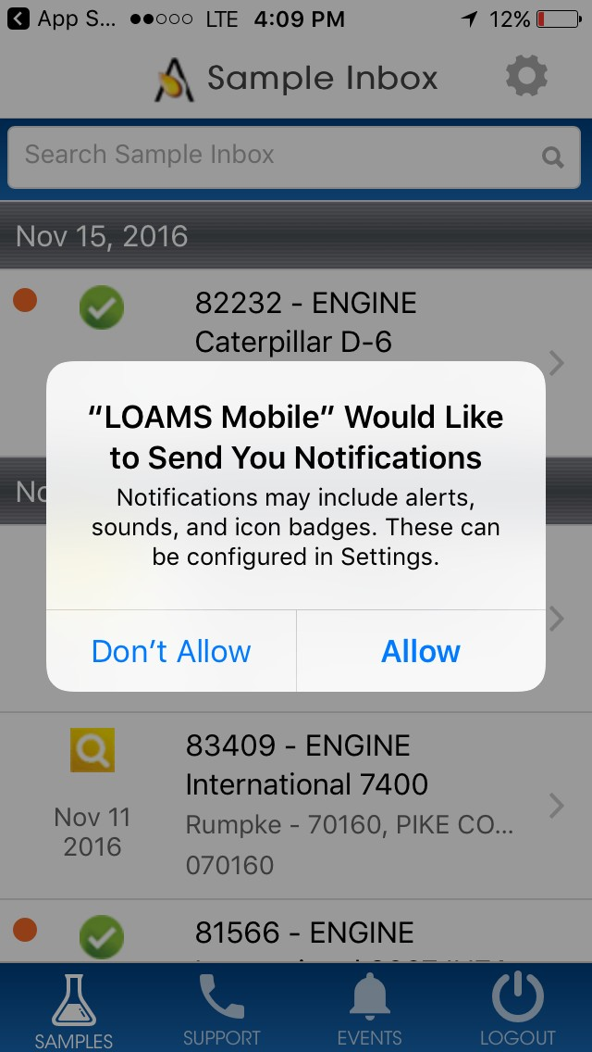
When prompted tap Allow to have LOAMS send you push notifications once samples are complete at the lab.

Slide 5
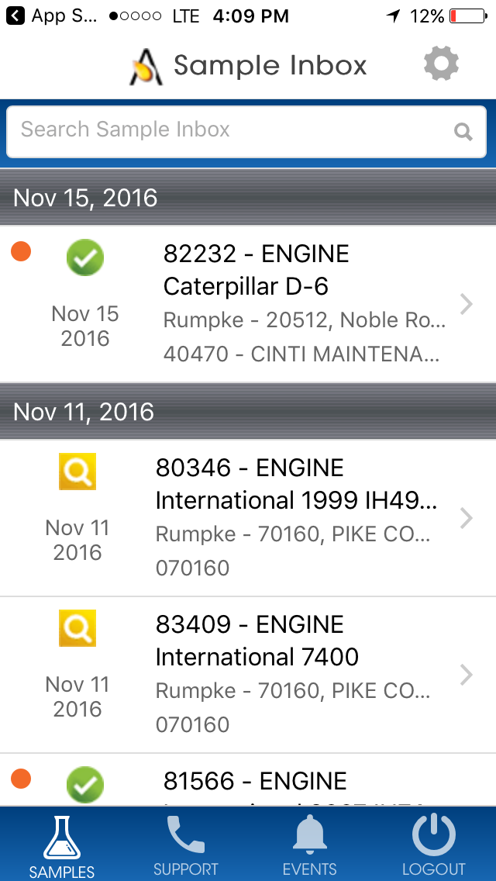
Once signed in you’ll see your sample inbox. Your most recent samples will be at the top. The orange dot means that the sample has not been viewed yet.
You can search for a sample by typing in the top search box.
Tap on the gear icon in the top right to sort your inbox.
Tap on a sample to view the sample details screen.

Slide 6
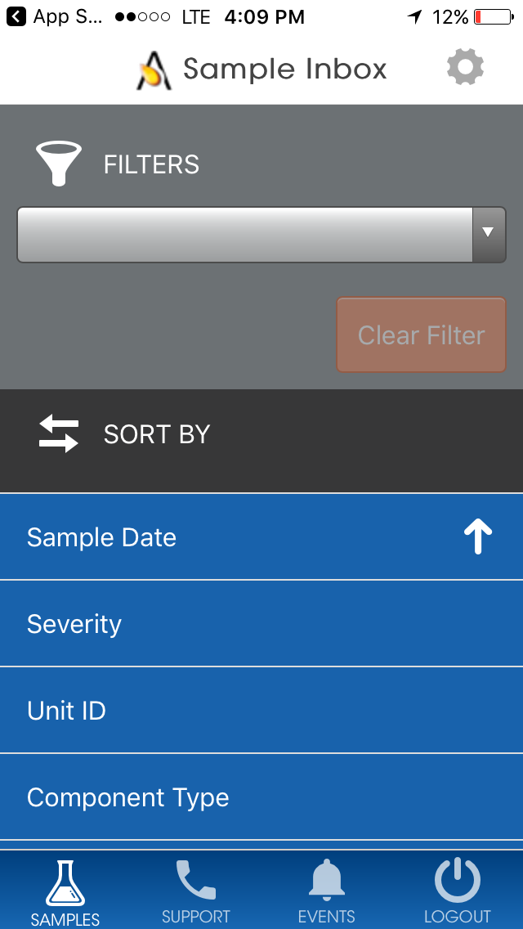
Select a filter you want to search by – please note that filters can only be set up on the desktop version of LOAMS, and some filters are not applicable to the mobile version of LOAMS.
You can sort your inbox by tapping on Sample Date, Severity, Unit ID, Component Type, or Customer Worksite, or by Date Range.

Slide 7
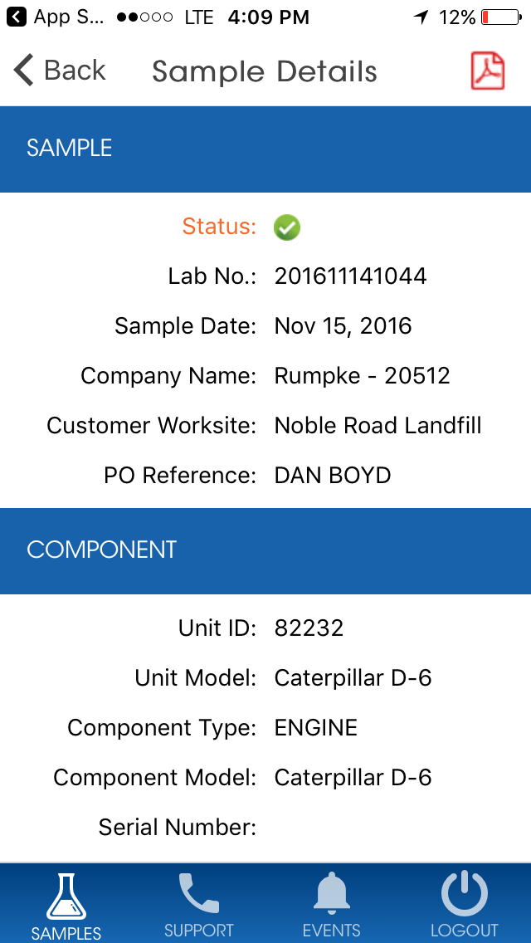
The Sample Details screen shows you details about the sample report. Tap on the icon on the top right of your screen to open the PDF version of your report.

Slide 8
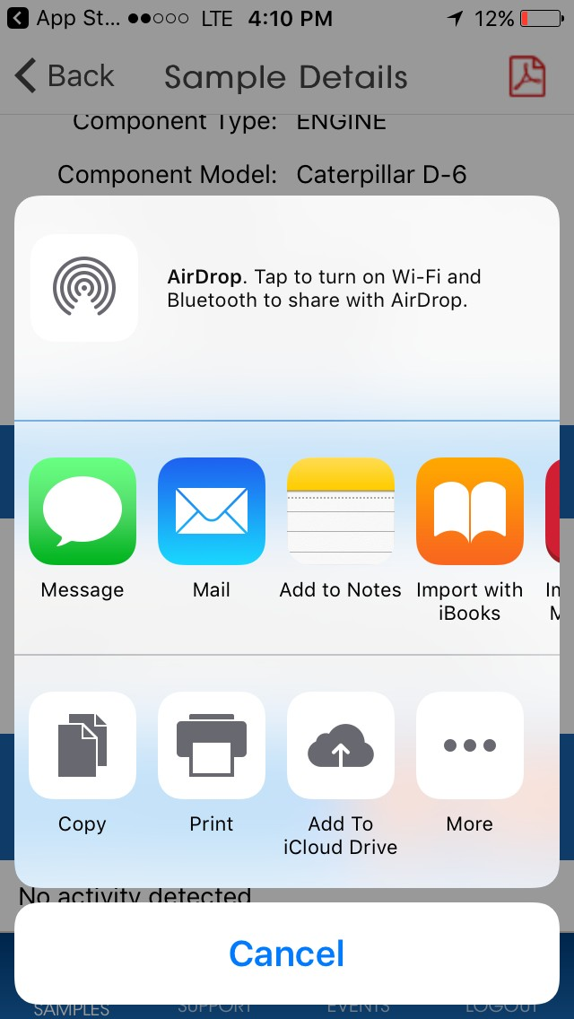
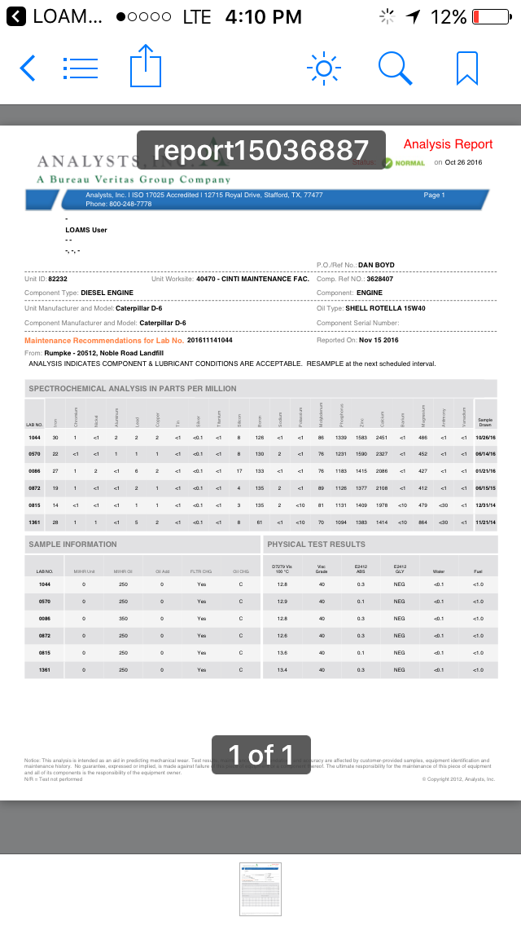
The LOAMS app allows you to open up the PDF in a variety of ways depending upon which apps you already have installed on your phone. You may also have the ability to message or email the reports from your phone.
Tap on Import with iBooks to open the PDF of the report.

Slide 9
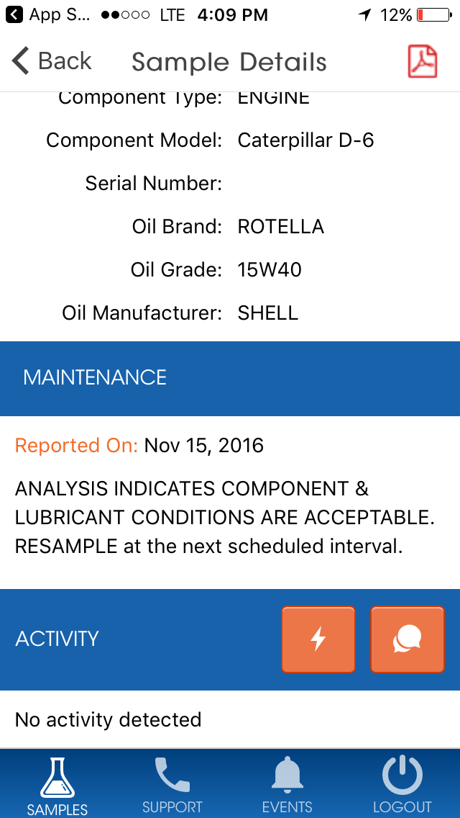
The bottom of the Sample details screen allows you to add sample actions and sample comments.
The lightning bolt icon allows you to assign a Sample Action
The chat bubble icon allows you to add comments to the sample.

Slide 10
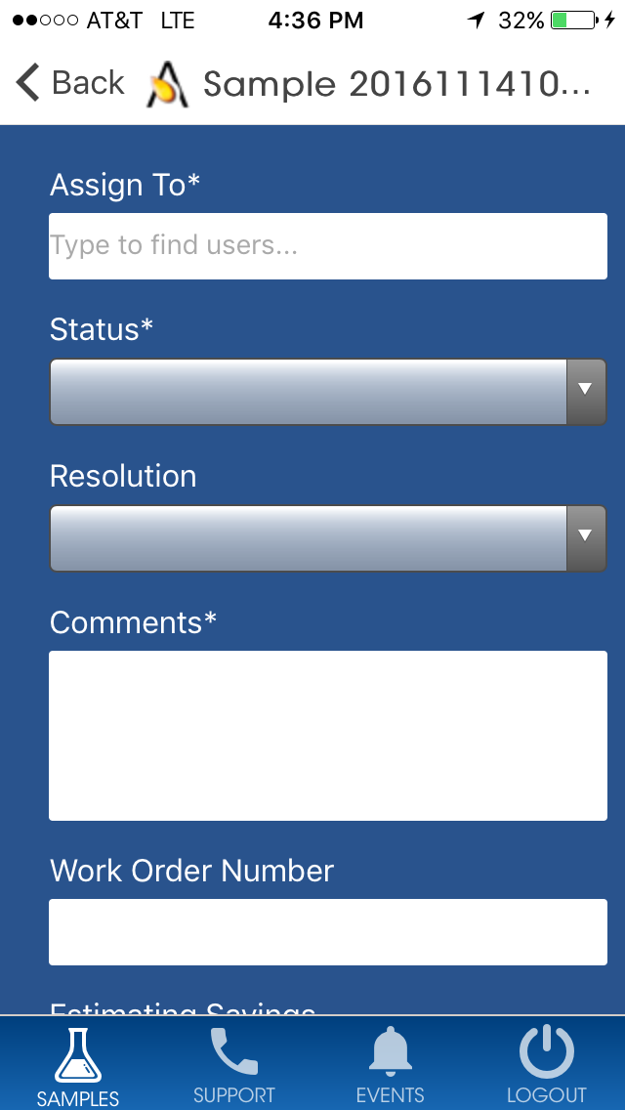
Assigning a sample action allows you to assign maintenance duties or follow up actions to your sample results.
First under assign to type in the email address you want to assign this sample action to
Tap on the drop down under Status to assign a status.
Enter in additional comments
Once complete click Save and an email will be sent to the person you’ve assigned the sample action to.

Slide 11
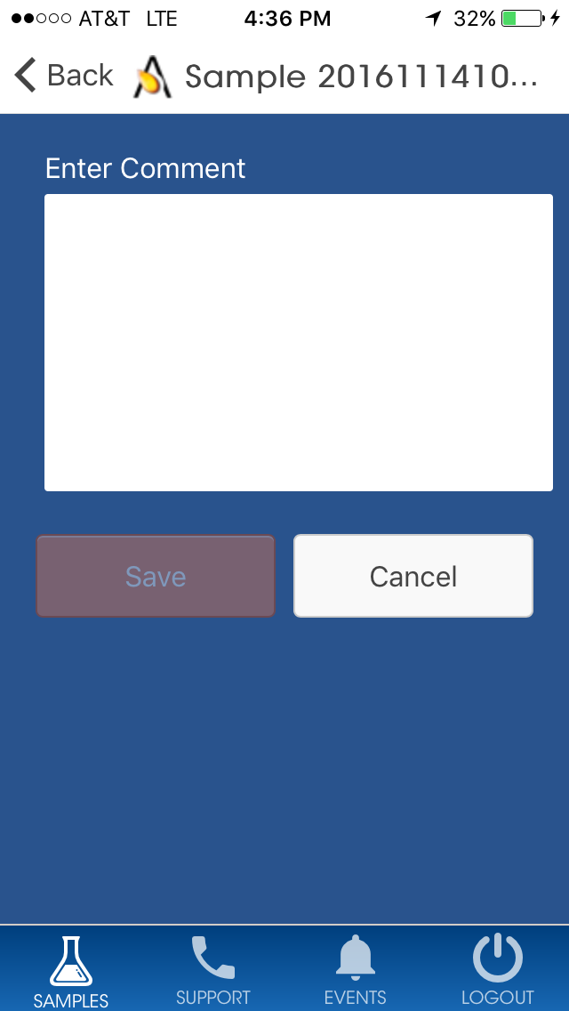
Sample Comment allows you to enter a comment and click save. This comment will appear under the sample details screen in the app.

Slide 12
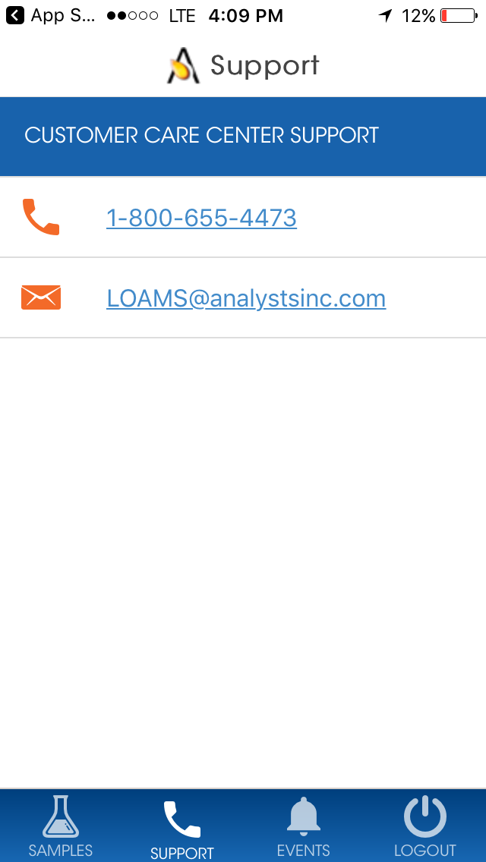
Tap on the Support icon to pull up the Customer Care Center support. Click on the phone number to call us or select on the E-mail address to send us an email message.

Slide 13
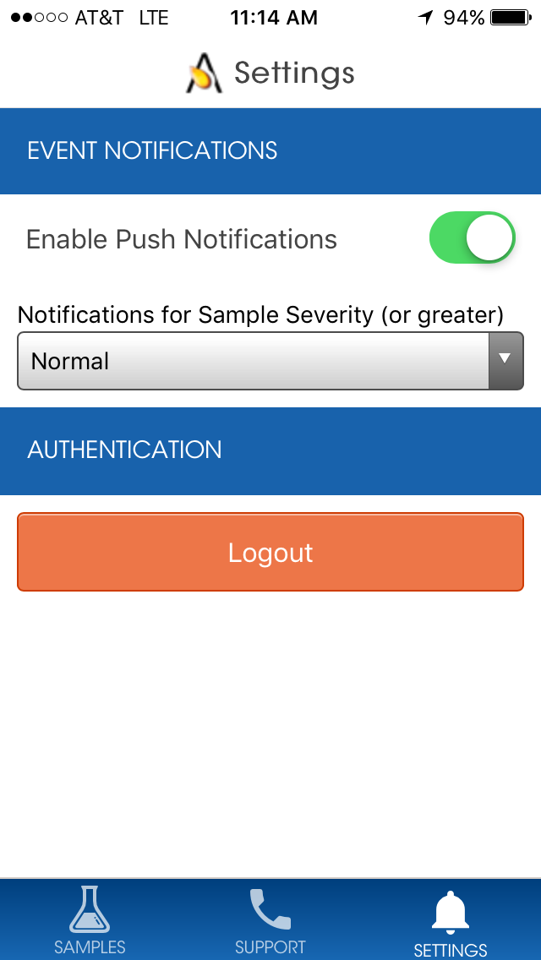
Tap on Settings to set up your notifications. To set up your push notifications slide your finger so that it turns green.
You can also select which severities you’d like to receive push notifications on by selecting the severity on the drop down list.
Note: Changing your settings in the app does NOT change your notification settings on the desktop version or change your email settings.

Slide 14
LOAMS® SUPPORT DESK:
Phone: 1-800-655-4473 Email: LOAMS@AnalystsInc.com
www.AnalystsIncOnline.com
www.AnalystsInc.com/LOAMS-Resource-Center

