Slide 1

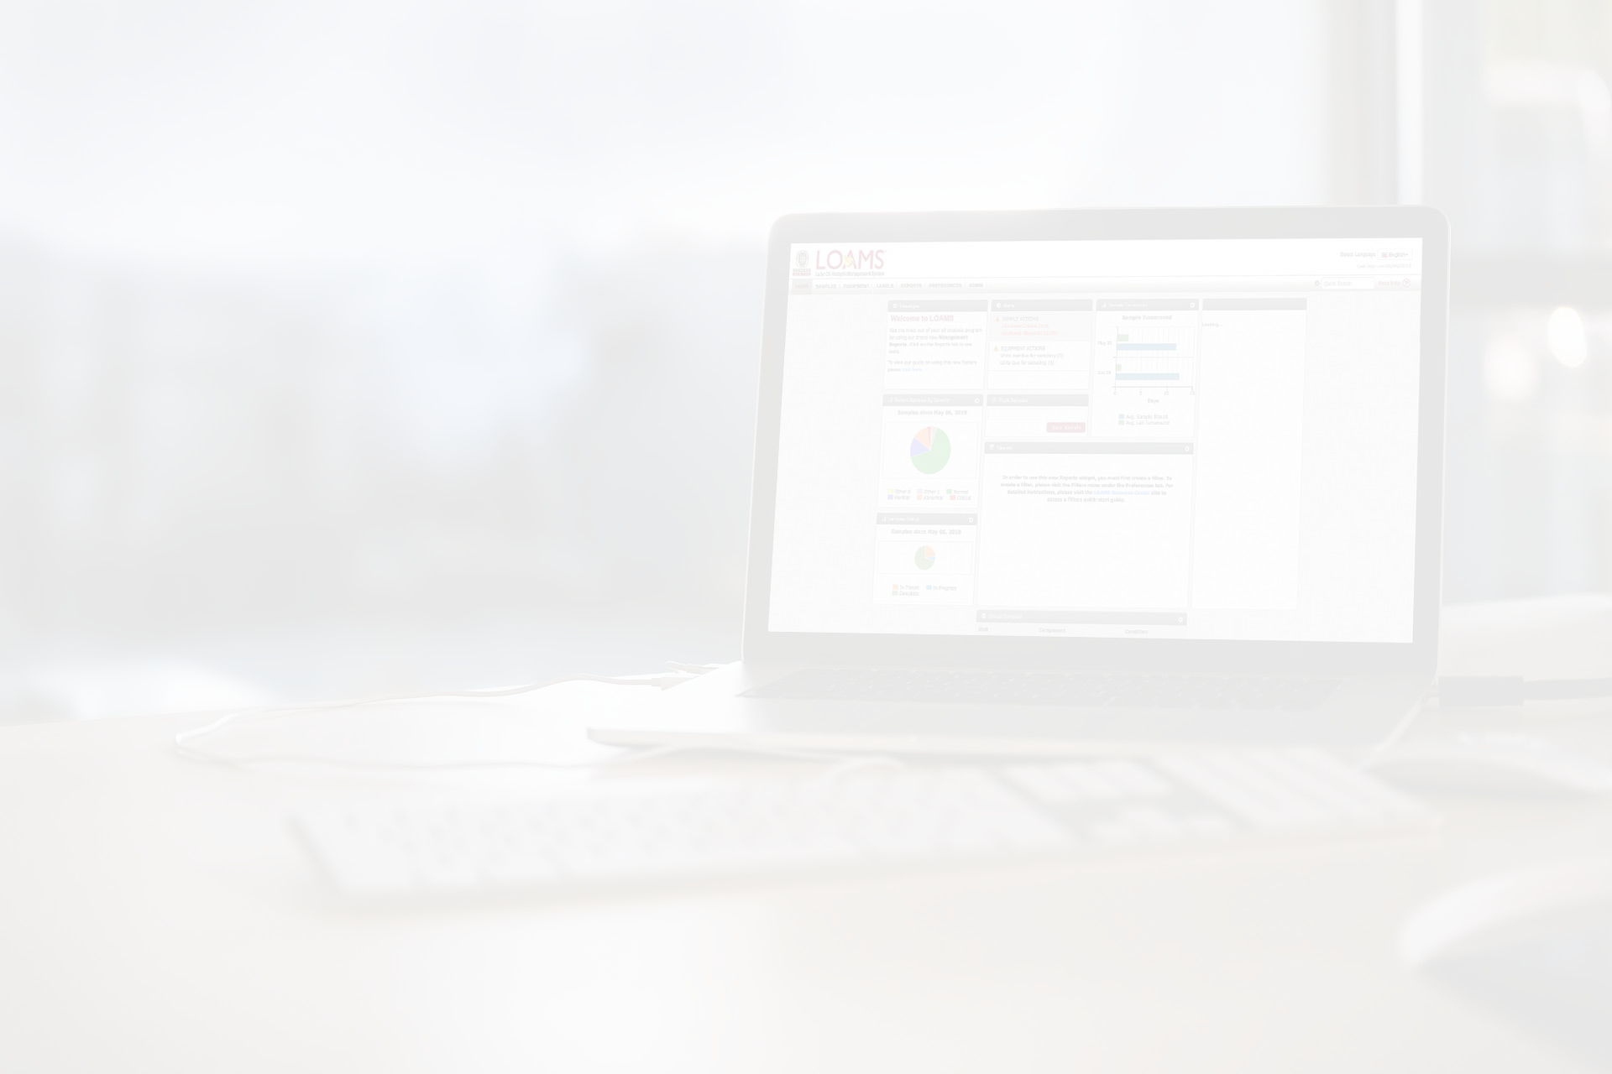




Quick Start Guide
Mobile App Quick Start Guide (iOS Version)

Slide 2
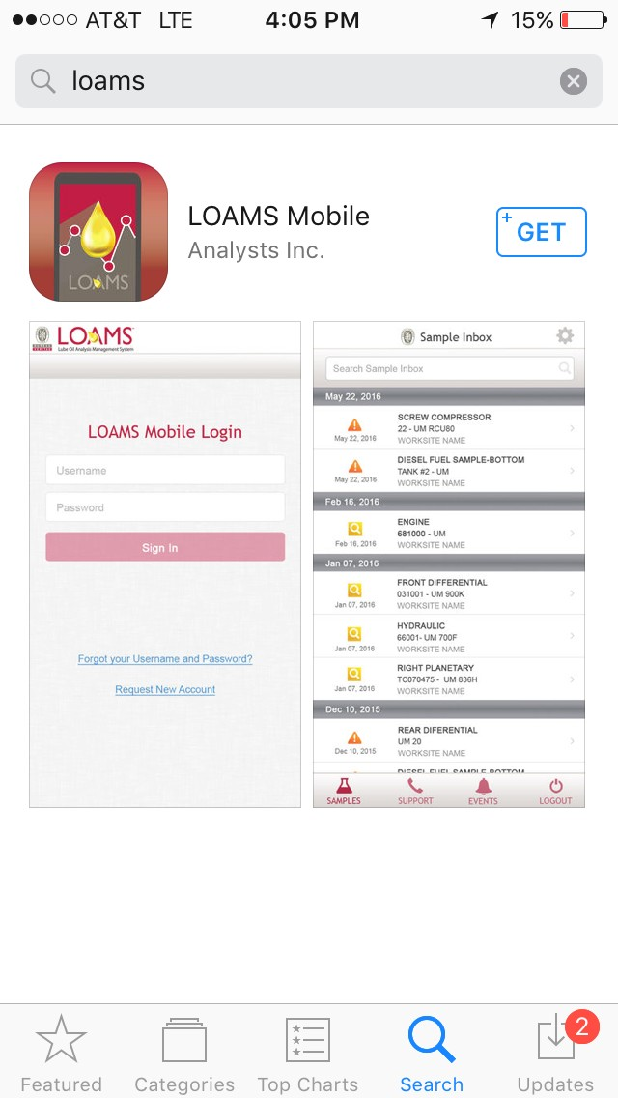


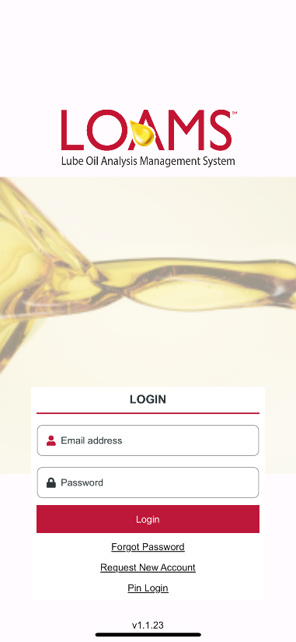
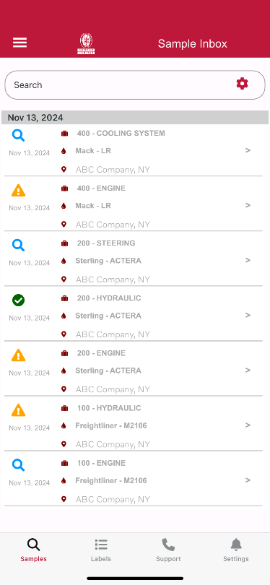

Finding the App in the App Store
Search the App Store
To find the app in the App Store, search for “LOAMS Mobile”.
Tap on the +GET button to install the app on your iPhone.

Slide 3

Sample Inbox
Sample Inbox
Once signed in, you’ll see your sample inbox. The most recent samples will be at the top.
You can search for a sample by typing in the top search box.
Tap on the gear icon in the top right to sort your inbox.
Tap on a sample to view the sample details screen.

Slide 4
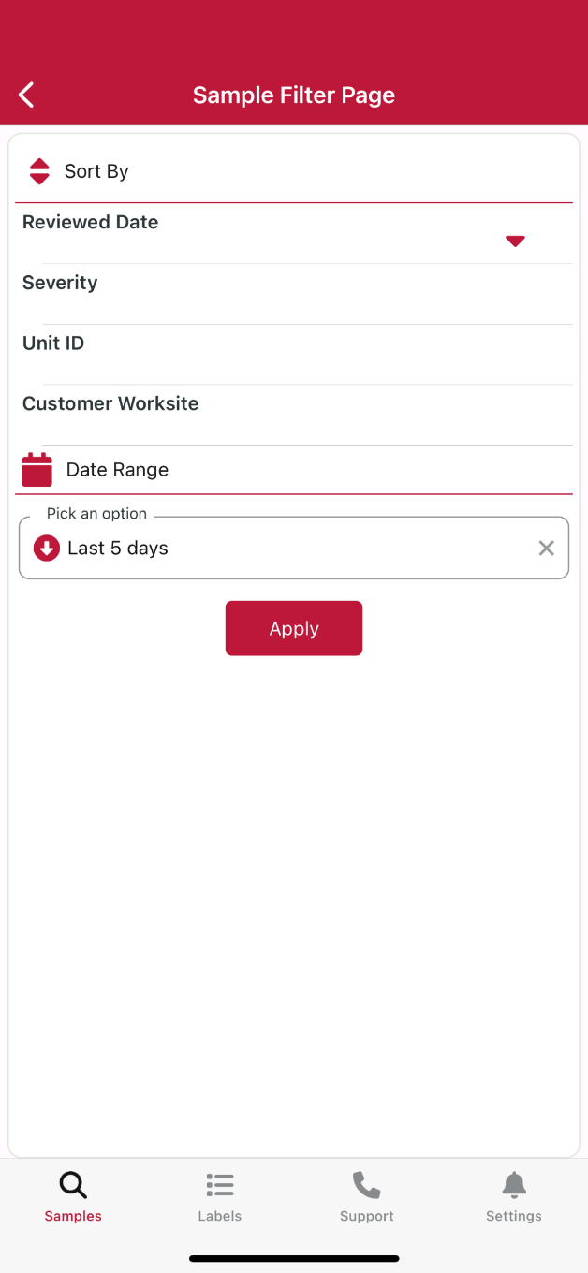
Sorting Your Inbox
Sorting Your Inbox
You can sort your inbox by tapping on the Reviewed Date, Severity, Unit ID and Customer Worksite buttons.
You can also sort by date range with the following options: Last Year, Last 6 Months, Last 90 Days, Last 60 Days, Last 30 Days, Last 15 Days and Last 5 days.
Make sure to click “Apply” once you configure your filters.

Slide 5
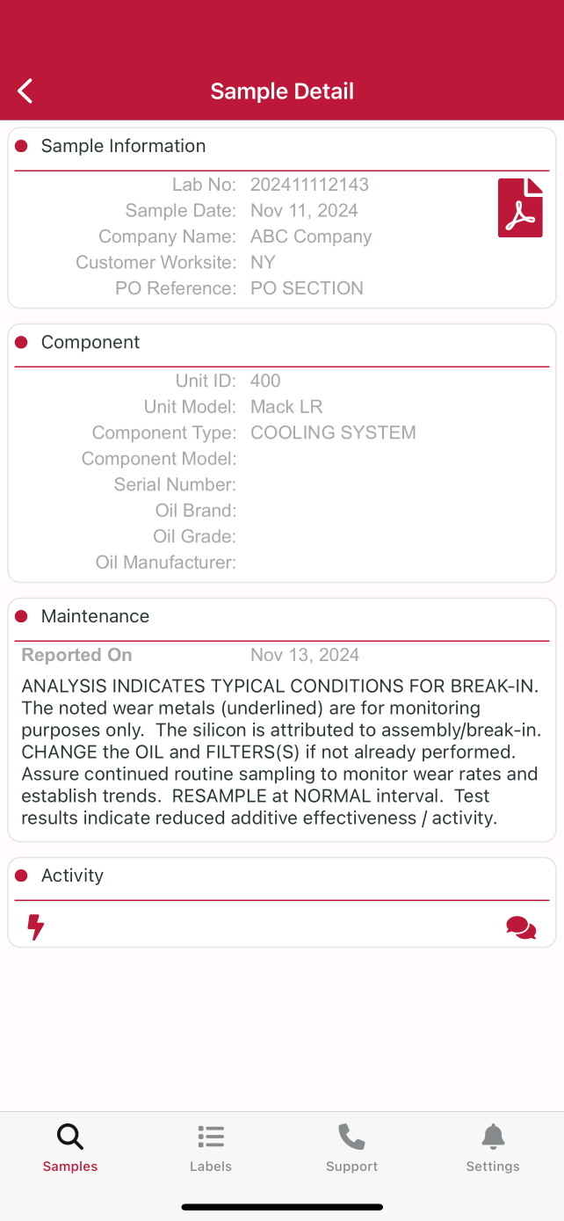

Sample Details
Sample Details
The Sample Details screen shows you details about the sample report. Tap the icon on the top right of your screen to open the PDF version of your report.

Slide 6
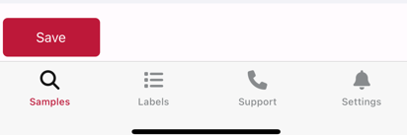
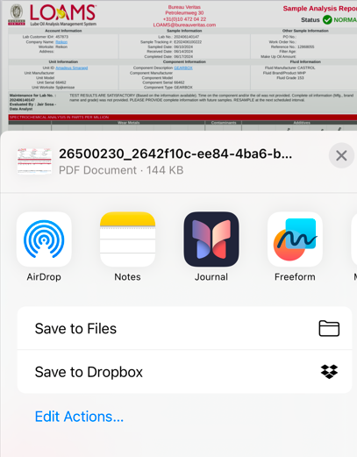
Downloading The Report
Downloading The Report
The LOAMS app allows you to open the PDF in a variety of ways depending upon which apps you already have installed on your device. You may have the ability to message or email the reports from your phone.
Tap the Save button in the lower right corner of the report viewer to see your options.

Slide 7
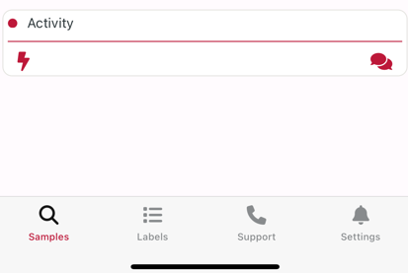
Sample Activity
Sample Activity
The buttons in the Sample Details page allows you to add sample actions and sample comments.
The icon allows you to assign an action.
The icon allows you to add comments to the sample.

Slide 8
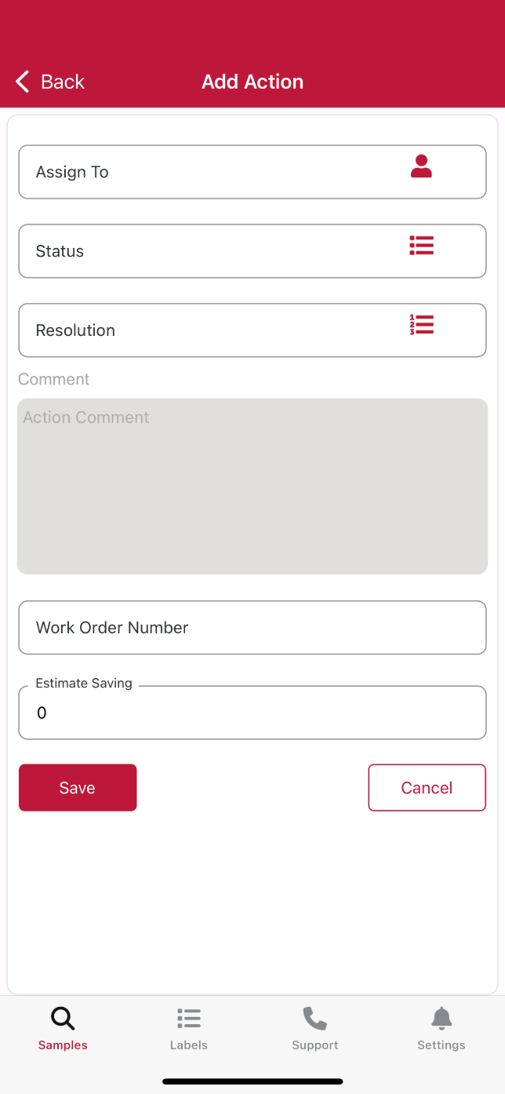
Sample Actions
Sample Actions
Assigning an action allows you to assign maintenance duties or follow up actions to your sample results.
First, enter a name or an email in the assign to field.
Tap on the drop down under status to assign a status.
Enter a resolution.
Enter comments, if applicable.
Enter a work order number, if applicable.
Enter an estimated savings, if applicable.
Once complete, click Save.

Slide 9
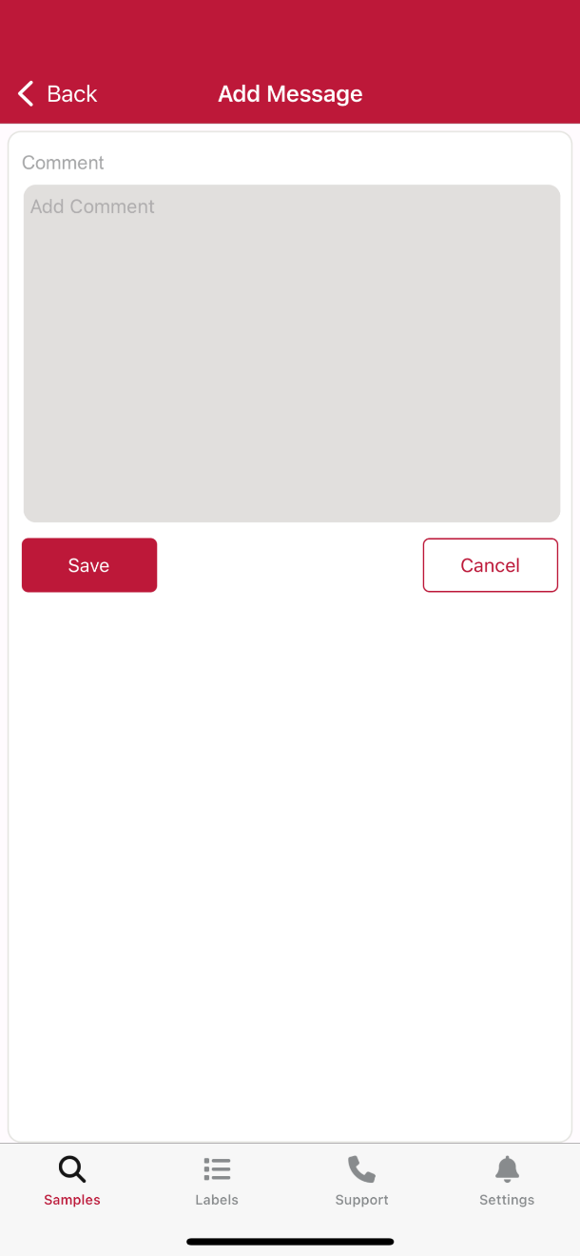
Sample Comments
Sample Comments
You can add a comment to a sample.
Enter your comment in the Add Comment section and click save.

Slide 10
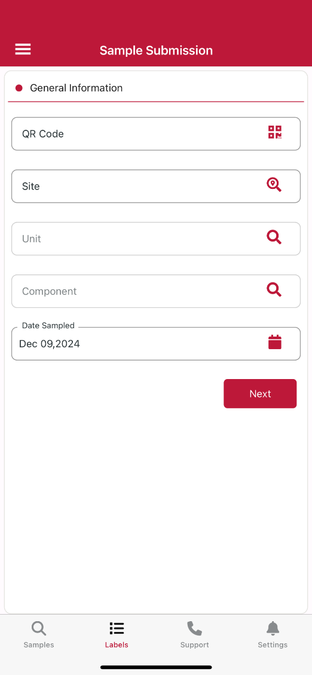
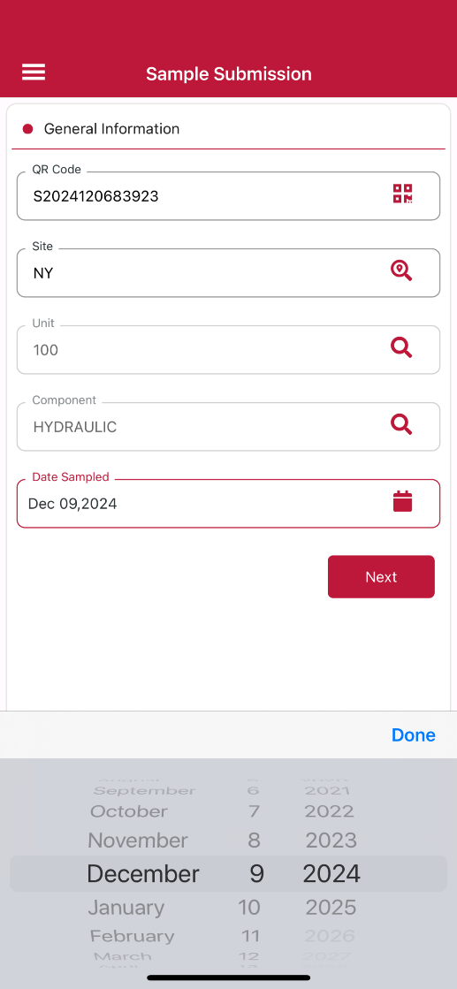
Labels
Labels: Registering a Sample
To begin, click the Labels tab. You will see Labels Page One with general information. Enter or scan your QR code. Next, you will need to select a worksite, unit and component in that order. Click the magnifying box to search and select your worksite, unit and component. Lastly, you’ll need to select a sampled date. This field automatically gets populated with todays date.

Slide 11
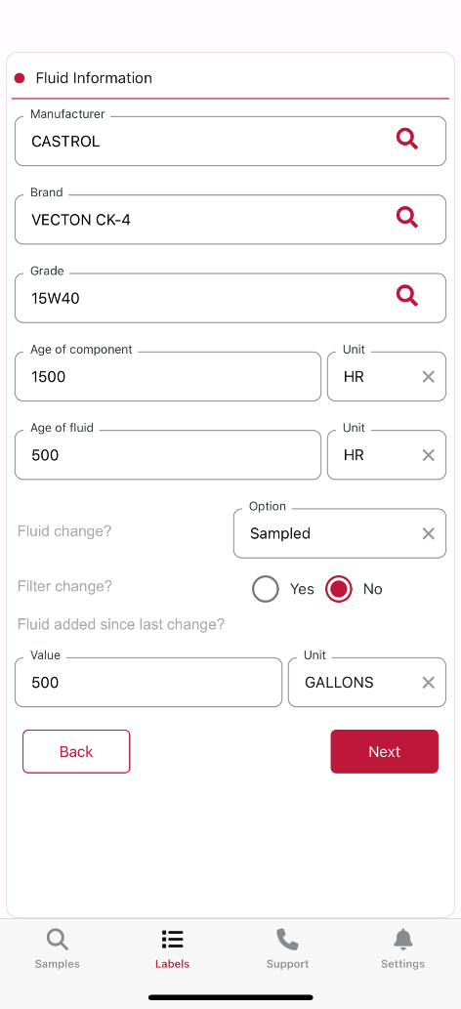
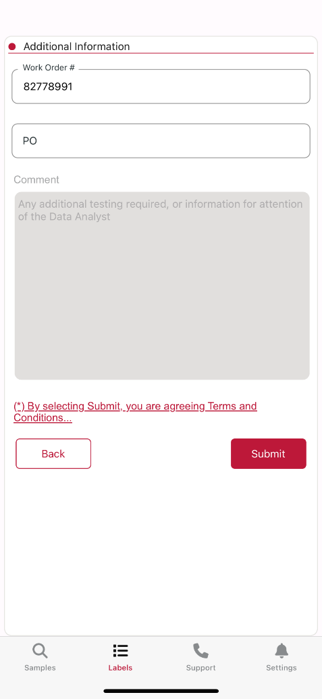
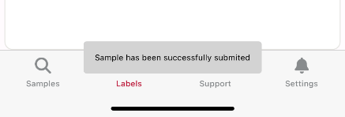
Labels
Labels: Registering a Sample Continued
In Labels Page Two, you will need to enter fluid and unit information. First, select an oil Manufacturer, Brand and Grade in that order. If you can’t find the oil product you’re looking for, contact our customer support.
You’ll also need to enter the component age + units, fluid age + units, fluid change, filter change and filter value + units. If you don’t know this information, enter “0”. Once complete, select the NEXT button.
Lastly, you’ll be directed to Labels Page Three to enter additional information, such as work order number, PO number and comments. The fields aren’t a requirement, so they can be skipped as needed. Once you click “SUBMIT”, your label submission process is complete.

Slide 12
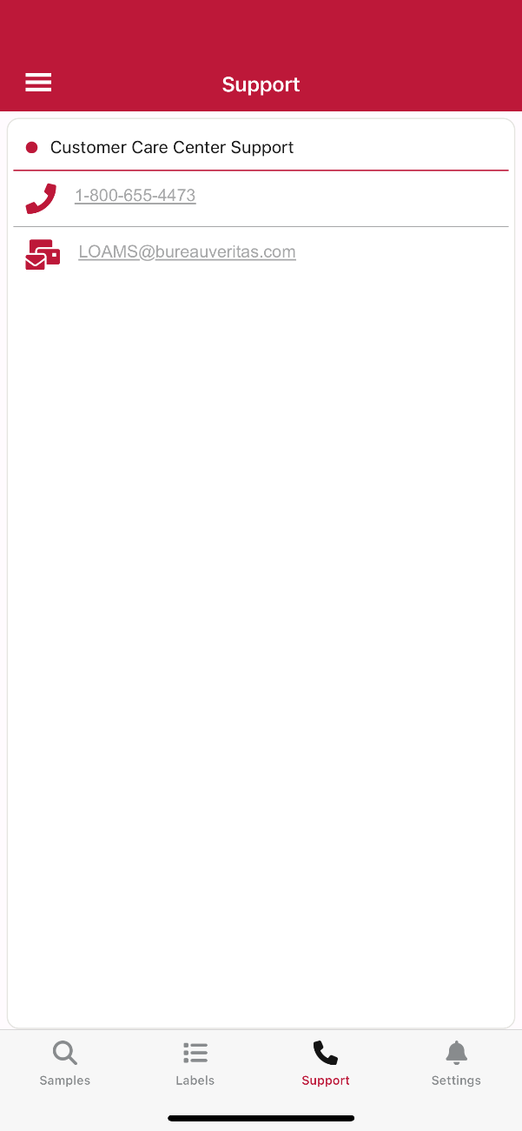
Support
Support
Tap the Support icon to pull up the LOAMS Support contact information. Click on the phone number to call us or select the email address to send an email.

Slide 13
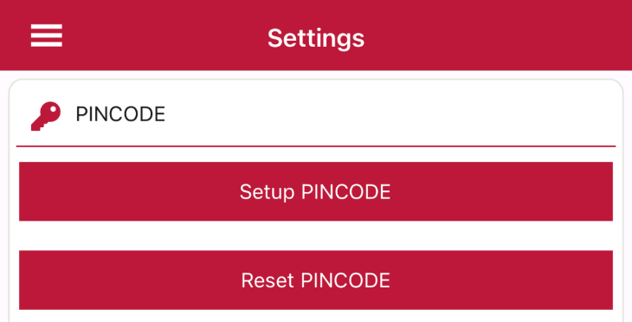
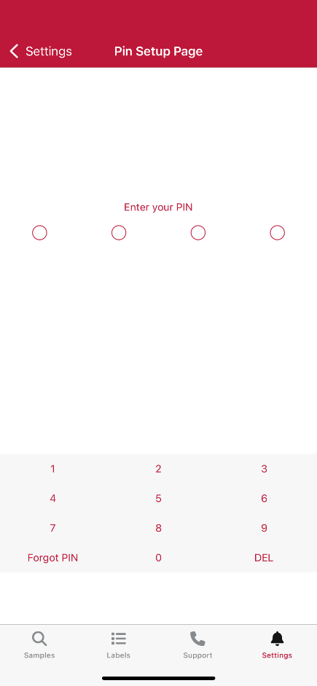
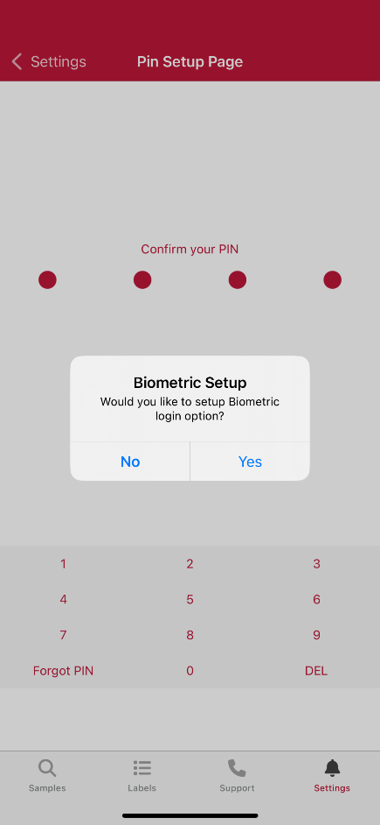
Settings
PINCODE Activation
You can create a PINCODE with or without biometrics. Biometrics are device specific and must be created prior to using Biometrics in the app.
For a PINCODE without Biometrics: Click the “Setup PINCODE” button. From there, you will be prompted to enter the PINCODE instead of your email and password at the login screen. You still have the option to go back and enter your email and password if you forgot your PINCODE.
For a PINCODE with Biometrics: click the “Setup PINCODE” button. From there, you will be prompted to enter a four digit code twice. Once complete, you will get a prompt to set up Biometrics. Say “YES” and it will be used. Moving forward, you will be prompted to use Biometrics at the login screen. You still have the option to use the PINCODE or go back and enter your email and password if you forgot your PINCODE.

Slide 14

Settings
PINCODE Reset
If you need to reset your PINCODE, please login to the app using your email and password. From there, go to the Settings tab and click “Reset PINCODE”. You will be prompted to confirm you’d like to reset your PINCODE. Click “YES”. You will receive a message letting you know you’ll need to log out and log back in. Once you login again, you can click the “Setup PINCODE” button and start fresh.

Slide 15



LOAMS SUPPORT DESK
Phone: 1.800.655.4473
Email: LOAMS@us.bureauveritas.com
LOAMS Platform | LOAMS Resource Center
Download the LOAMS Mobile App today:

